Slide 1

CREDIT CARD TRANSACTION FRAUD DETECTION
By Sai Vamshi Atukuri

Slide 2
Index
What is a transaction fraud?
Problem statement
Exploratory Data Analysis
Issues with the data
Modelling Results
Sampling Results
Proposed model
Scope of improvement

Slide 3
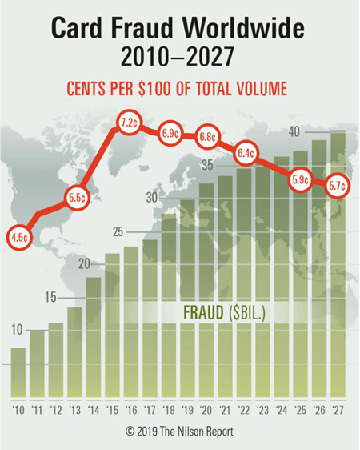
WHAT ARE TRANSACTION FRAUDS AND HOW BIG ARE THEY?
When a stolen or lost card is used to generate an unauthorized transaction.

Slide 4
Problem Statement
Current Strategy
Multi-factor authentication for any transaction greater than 2000.
Approve the transaction only when the customer confirms
Proposed Strategy
Use the historical fraud transactions data and ML techniques to detect frauds intelligently.
MFA for only transactions detected as the fraud by the ML model.
Fraud transactions lesser than 2000 are unnoticed.
Good customers transacting more than 2000 are inconvenienced.
Frauds are detected using the historical behaviour of customers and hence providing better customer experience and fraud detection.

Slide 5
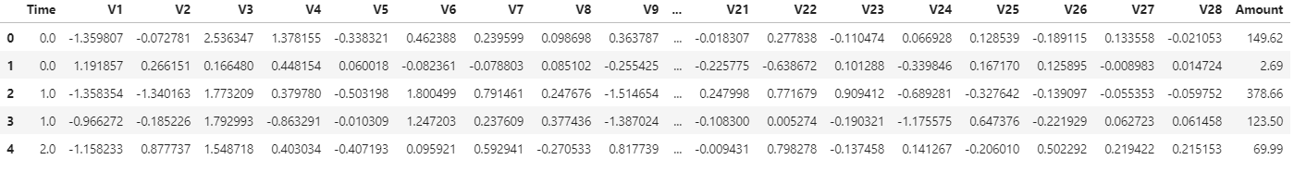
A PEEK INTO THE DATA
Most of the data is masked using PCA transformations to protect customer identity.

Slide 6
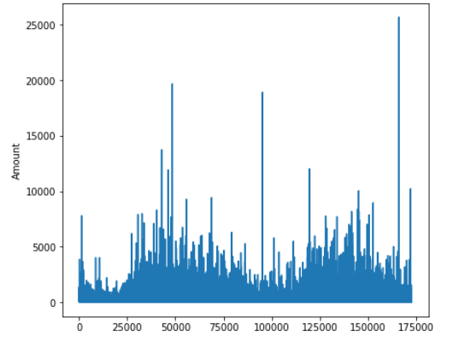
AMOUNT TRANSACTED PER SECOND

Slide 7
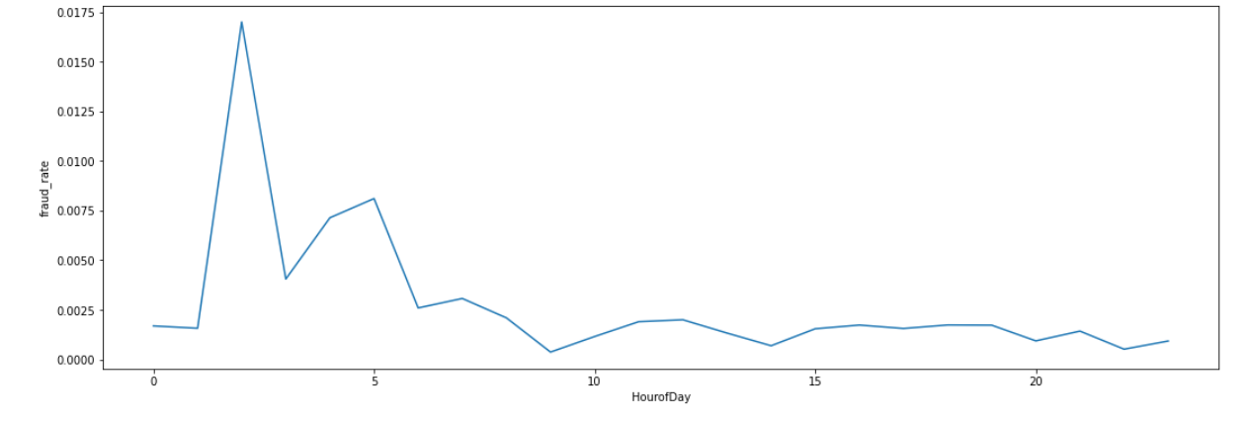
FRAUD RATES AT DIFFERENT HOURS OF THE DAY
High fraud rate during early hours

Slide 8
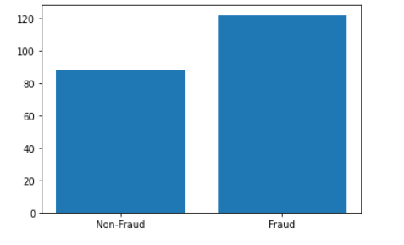
AVERAGE TRANSACTION AMOUNT – FRAUDS VS NON-FRAUDS
Average transaction amount of frauds is greater than that of non-frauds

Slide 9
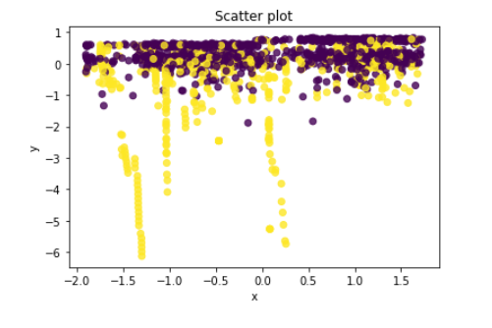
PRINCIPAL COMPONENT ANALYSIS FRAUDS VS NON-FRAUDS
Good separation between frauds and non-frauds

Slide 10
ISSUES WITH THE DATA
VERY LESS EVENT RATE
BIG OUTLIERS
LARGE AMOUNT OF DATA

Slide 11
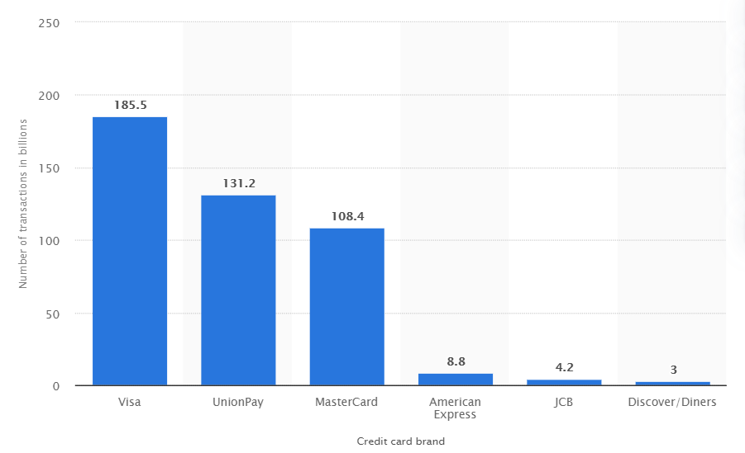
ISSUE 1: LARGE AMOUNT OF DATA
Number of purchase transactions on payment cards worldwide in 2019, by brand(in billions)
Use big data techniques like Hadoop and Spark to pre-process data and Cloud to implement the model.

Slide 12
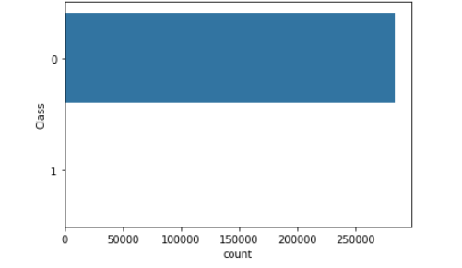
ISSUE 2: LOW EVENT RATE
Count of Frauds and Non-Frauds in the dataset
284315
Use sampling techniques or anomaly detection techniques to reduce the bias towards majority class.
Don’t use accuracy to measure performance of the model.
492

Slide 13
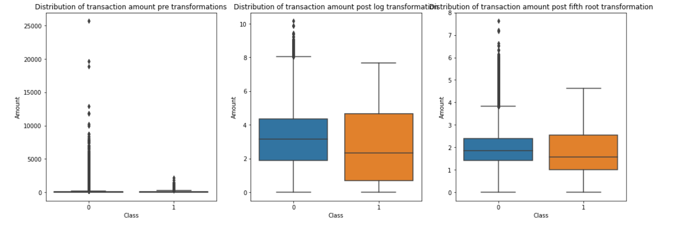
ISSUE 3: BIG OUTLIERS
Box Plot of Transaction Amount for frauds and non-frauds
Outliers cannot be removed as they can detect frauds.
Hence transformations are preferred.

Slide 14
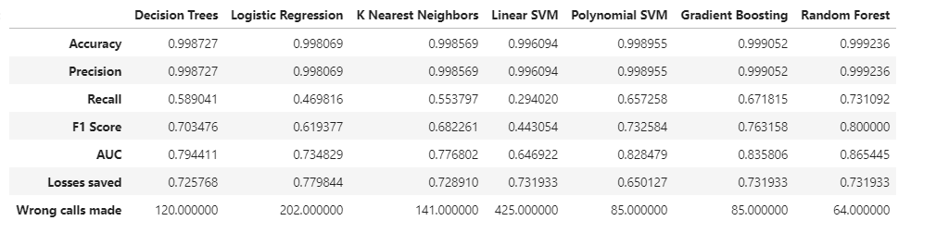
Modelling Results
Under Sampling is done for all the above models.
Best F1 Score – Random Forest
Frauds Captured – Logistic Regression
Least wrong calls made – Random Fotest

Slide 15
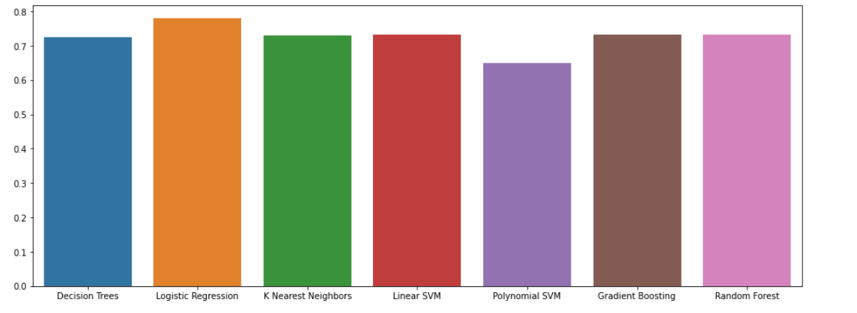
Models Comparison – Frauds detected
Recall is the proxy to frauds detected.

Slide 16
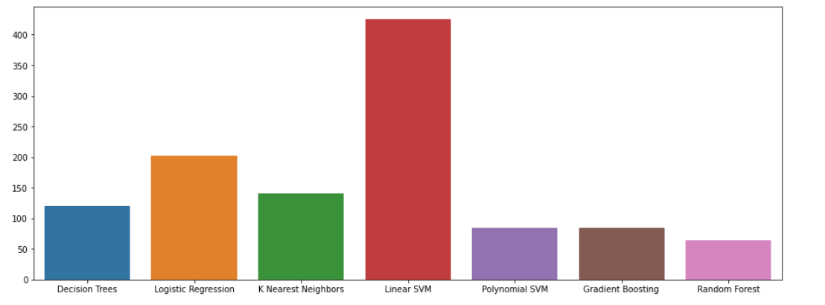
Models Comparison- Wrong calls made due to model output
Precision is the proxy to wrong calls made

Slide 17
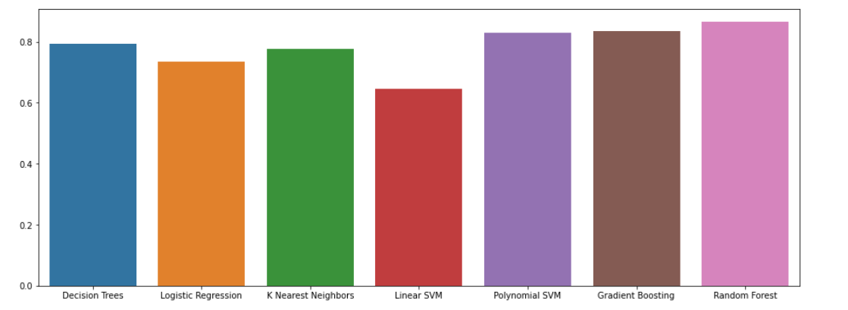
Models Comparison - AUC
Precision can be used if the aim is to improve customer service
Recall can be used if the aim is to be detect as many frauds as possible.
A good balance between both would be F1 Score or AUC.

Slide 18
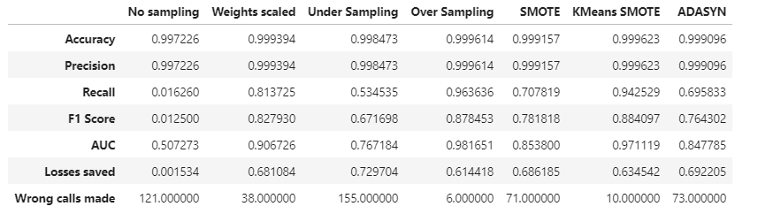
Sampling techniques Results
Light GBM is used as the base to compare different sampling techniques.

Slide 19
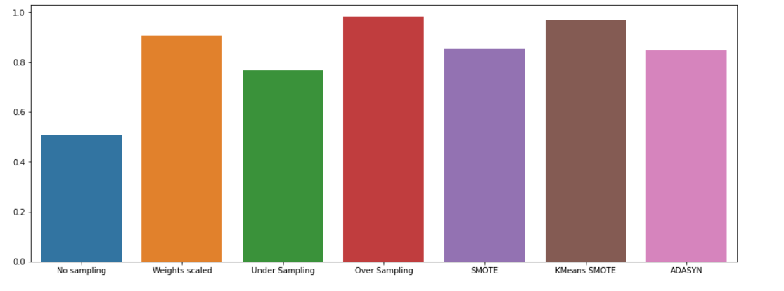
Sampling techniques Comparison - AUC
KMeans SMOTE and Over Sampling techniques gave the best AUC

Slide 20
How to choose the final model?
Goal | Best Model
Strict local regulatory standards | Logistic Regression or Decision Trees
Improving customer service | Model with the best precision
Detecting as many frauds as possible | Model with the best recall
Good balance between customer service & Fraud detection | Model with the best F1 Score or AUC
Balance the cost of false positives and cost of false negatives | Model with the best adjusted F1 Score
False Positive – Operations cost of the wrong phone calls and the bad customer service
False Negative – Losses due to fraud

Slide 21
Proposed Model
Among the models built, Light GBM with oversampled data gave the best balance between less wrong calls and more frauds captured.
Compared to the old strategy, there is a >200% decrease in wrong calls made and >400% increase in the frauds captured.

Slide 22

Scope of Improvement
Unmasked variables for better visualizations and better feature generation
Hyperparameter tuning
Anomaly detection techniques like Isolation Forest, One Class SVM and AutoEncoders
PySpark to pre-process the data

Slide 23
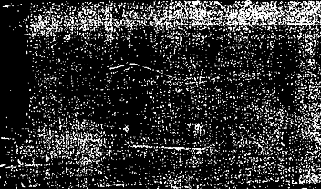

THANK YOU!

